Slide 1
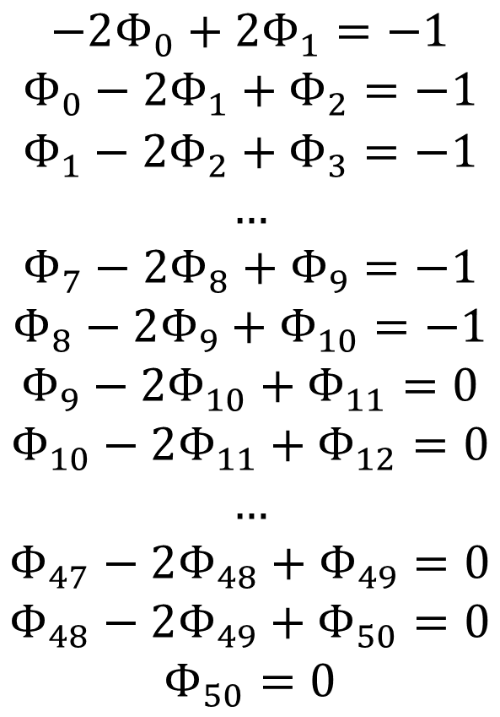
$$−2Φ_{0}+2Φ_{1}=−1$$
$$Φ_{0}−2Φ_{1}+Φ_{2}=−1$$
$$Φ_{1}−2Φ_{2}+Φ_{3}=−1$$
$$…$$
$$Φ_{7}−2Φ_{8}+Φ_{9}=−1$$
$$Φ_{8}−2Φ_{9}+Φ_{10}=−1$$
$$Φ_{9}−2Φ_{10}+Φ_{11}=0$$
$$Φ_{10}−2Φ_{11}+Φ_{12}=0$$
$$…$$
$$Φ_{47}−2Φ_{48}+Φ_{49}=0$$
$$Φ_{48}−2Φ_{49}+Φ_{50}=0$$
$$Φ_{50}=0$$

Slide 2
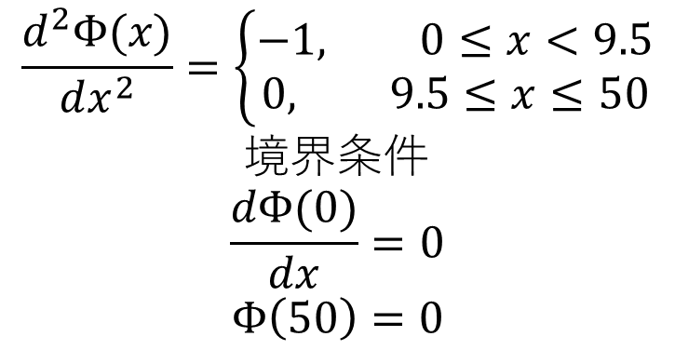
$$\frac{d^{2}Φ(x)}{dx^{2}}=\left\{\begin{aligned}−1, 0≤x<9.5 \\ &0, 9.5≤x≤50\end{aligned}\right.$$
$$境界条件$$
$$\frac{dΦ(0)}{dx}=0$$
$$Φ\left(50\right)=0$$

